Slide 1
SMART RESTAURANT ORDERING & BILLING SYSTEM
Group Members: 1.NAMAN JAIN(0827IT151068)
2.NITIN BAGHEL(0827IT151076)
3.PRANJAL SONI(0827IT151082)
4.ROSHAN MAHAJAN(0827IT151090)
5.SACHIN G.PATIDAR(0827IT151093)
Submitted to Department of Information Technology

Slide 2
Project Presentation Outline
2
Abstract
Introduction
Problem Statement
Survey of Existing Systems
Project Objectives
Models and Diagrams
The implementation
Testing
Conclusions and Limitations

Slide 3
Abstract
3
The project “Smart Restaurant Ordering and Billing System” is implemented to reduce the manual work and enhances the accuracy of work in a restaurant. This project has been made in a user friendly interface. The menu card consists of various food varieties available in the restaurant. The billing system prepares the bill according to the delivered food. This system entirely reduces the unnecessary time waste inside the restaurant

Slide 4
Introduction
4
The project “Smart Restaurant Ordering and Billing System” has a user friendly interface. The menu card consists of various food varieties available in the restaurant. The billing system prepares the bill according to the delivered food.
This project aims to automate the food ordering and billing process in restaurant as well as to improve the dining experience of customers. The system on user’s table will have all the details of his account as well as menu. Touch screen provides fast access to any and all types of digital media, with no text bound interface getting in the way.

Slide 5
The Problem Statement
5
The traditional food ordering system is entirely a manual process which involves waiters, pen and paper. The customer has to wait for waiters to take the order. The waiter notes down the orders from customers, take these orders to kitchen department, update them in records and again make the bill. Though this system is simple; it may involve errors while noting down the orders as well as in making calculations.
To overcome these limitations in manual system, smart restaurant ordering and billing system developed to automate food ordering process. By using Smart Restaurant Ordering System, the ordering system is made more efficient and can help the manager to avoid human error and enhance business development

Slide 6
Survey of Existing Systems
6
In many popular restaurants, waiters/waitresses tend to miss out on tables or customers calls during busy hours potentially decreasing ones clientele. While this is an ongoing issue, there is still no product that drastically improves the communication between the servers and the customers in the current market.
NAME OF RESTAURENT | ADDRESS | DEMERITS
Guru Kripa | Near Sarwate Bus Stand Indore | Due to manual work sometime.
 |  | order misplassed
Sai kripa restaurent | Near Patnipura circle Indore | Workers are not educated so
 |  | sometimes there is problem to
 |  | communicate the order.
Dilli Drawar restaurent | Near Anand Bazar indore | Limited workers are present, on
 |  | Saturday and Sunday they are
 |  | unable to manage customers
 |  | order.

Slide 7
Objectives
7
We propose to build a software project that can efficiently handle and manage various activities of a restaurant and all these activities will be happening under the supervision of the administrator. The businesses in restaurants are now growing constantly. At the same time, the need for managing its operations and tasks arises. This project serves the best way of maintaining customer’s information and caters their needs.
.

Slide 8
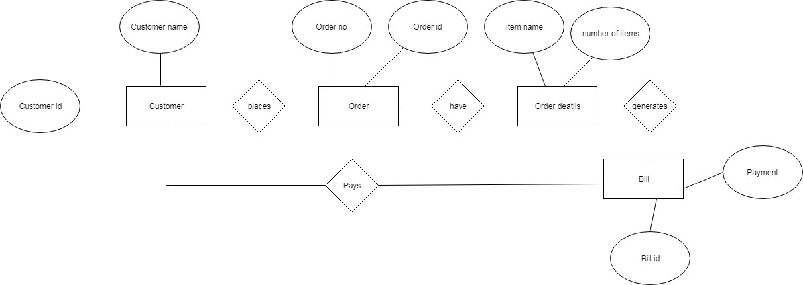
E R - Diagram
An entity-relationship diagram (ERD) is a data modeling technique that graphically illustrates an information system’s entities and the relationships between those entities. An ERD is a conceptual and representational model of data used to represent the entity framework infrastructure.

Slide 9
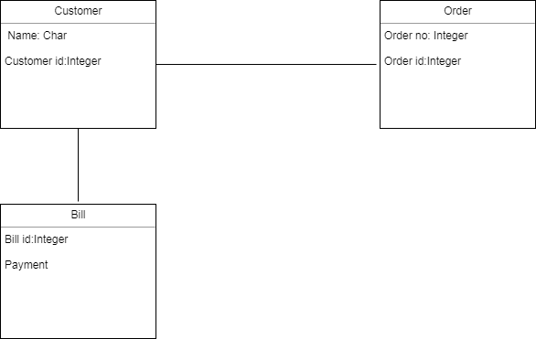
UML Diagrams
1.Class Diagram:-
A class diagram is a type of diagram and part of a unified modeling language (UML) that defines and provides the overview and structure of a system in terms of classes, attributes and methods, and the relationships between different classes.

Slide 10
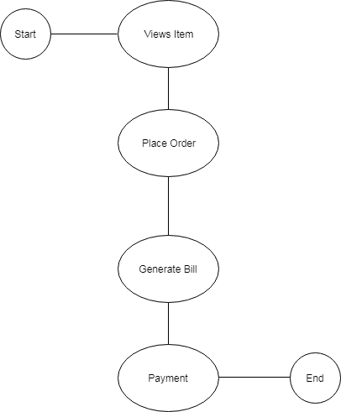
2. Activity Diagram:-
2.Activity Diagram:-
In Unified Modeling Language (UML), an activity diagram is a graphical representation of an executed set of procedural system activities and considered a state chart diagram variation. Activity diagrams describe parallel and conditional activities, use cases and system functions at a detailed level

Slide 11
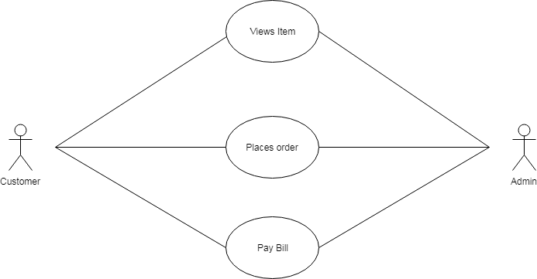
3. Use Case Diagram Diagram:-
A use case is a software and system engineering term that describes how a user uses a system to accomplish a particular goal. A use case acts as a software modeling technique that defines the features to be implemented and the resolution of any errors that may be encountered

Slide 12
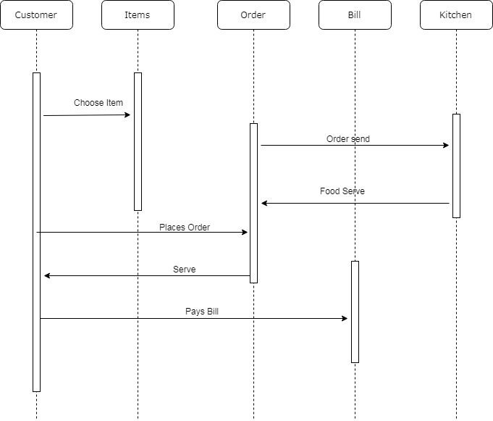
4.Sequence Diagram:-

Slide 13
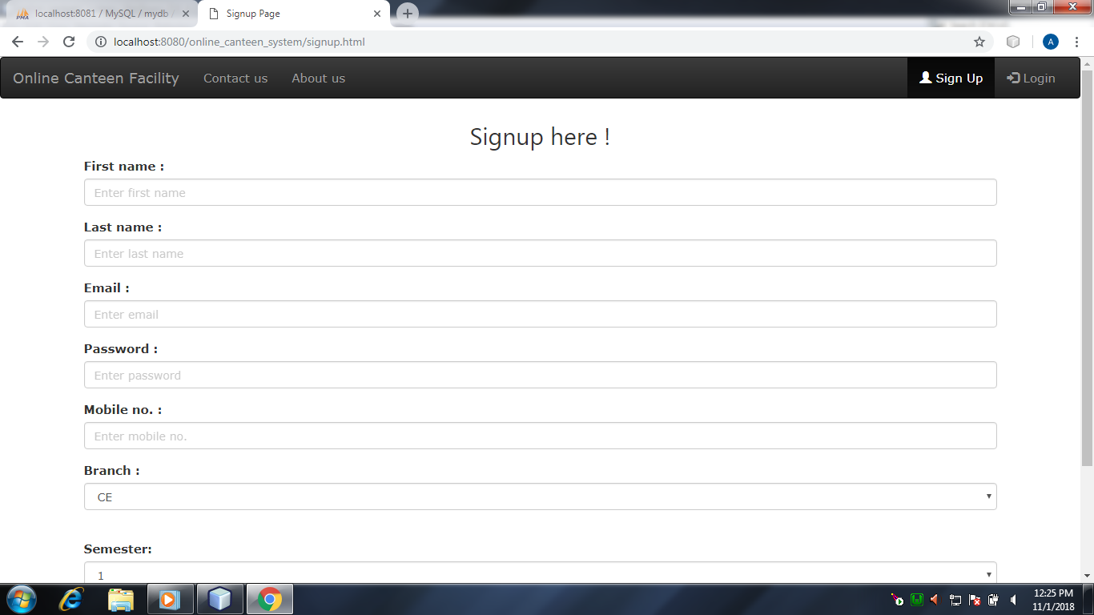
Implementation
11
Snapshots of modules developed along with proper demonstration

Slide 14
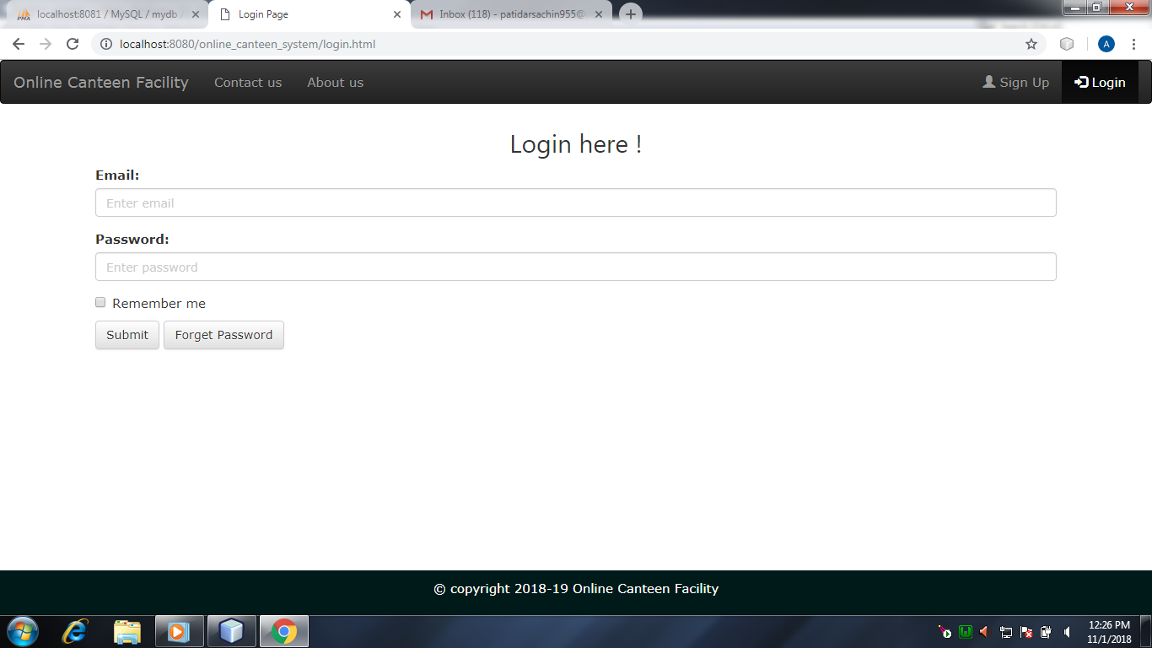

Slide 15
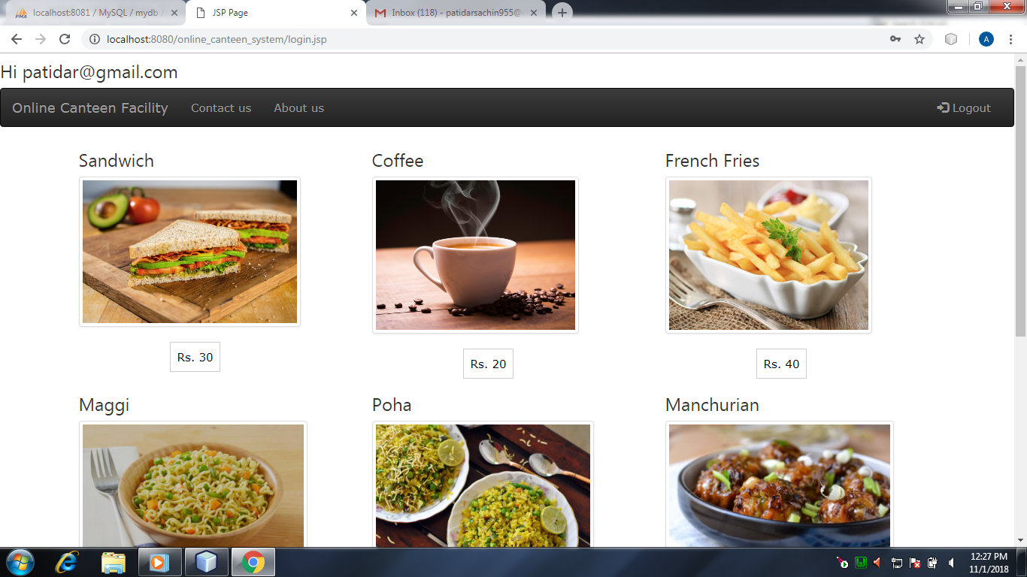

Slide 16
Testing/Test Cases
12
Tests can be conducted based on two approaches –
1.) Functionality testing
2.) Implementation testing
The texting method used here is Black Box Testing. It is carried out to test functionality of the program. It is also called ‘Behavioral’ testing. The tester in this case, has a set of input values and respective desired results.

Slide 17
Conclusion and Limitation
The proposed system is based on user’s need and is user centered. The system is developed in considering all issues related to all users which are included in this system. Wide range of people can use this if they know how to operate it. Various issues related to Restaurant Service will be solved by providing them a full-fledged system. Thus implementation of Smart Restaurant Ordering and Billing system is done to help and solve one of the important problems of people.
The system currently requires a physical computer to act as a localized s storage and any sorts of failure of that computer will affect the entire system’s usability. The system currently doesn’t support any payment gateways. The system requires Digitalized table which will contain inbuilt touch screen menus which will be too much costlier.

